Slide 1
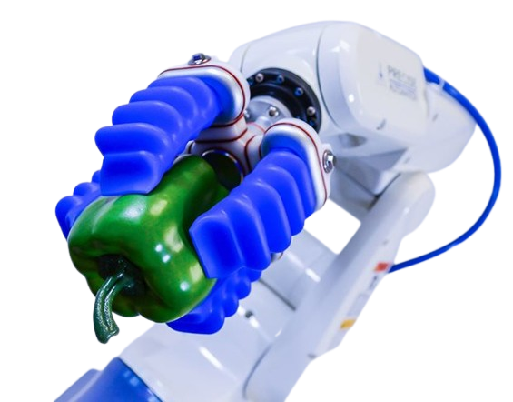

SOFT ROBOTICS
CS6271-EVOLUTIONARY COMPUTATION AND HUMANOID ROBOTICS
PRESENTED BY :
ASHIK KANNAMPILLY JANARDHANAN[25032615]
GOVIND PATHAK[25020749]
SARANYA SHALU[ 25013912]
SOWMIYA RAMARAJ[25051091]

Slide 2
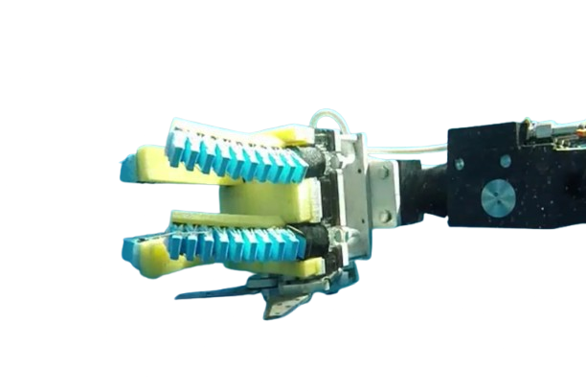
TABLE OF CONTENTS
01
INTRODUCTION
CONTROL AND MODELING CHALLENGES
06
WHY SOFT ROBOTICS ?
REAL WORLD APPLICATIONS
02
07
SOFT ROBOTICS VS TRADITIONAL ROBOTICS
FEATURES CHALLENGES
03
08
ACTUATORS MECHANISMS
FEATURE SCOPE AND OPPORTUNITIES
04
09
MANUFACTURING TECHNIQUES
CONCLUSION
05
10

Slide 3
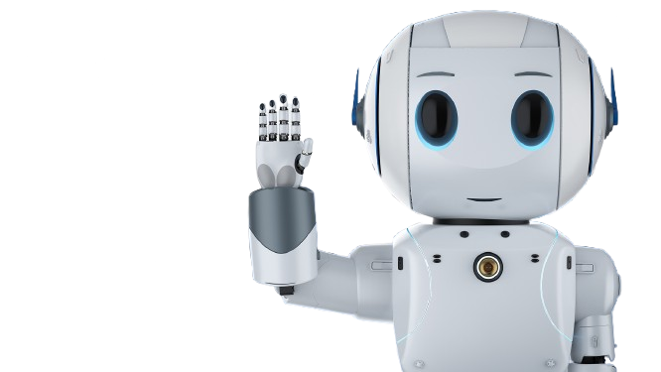
INTRODUCTION
A branch of robotics that uses soft, flexible, and deformable materials.
Materials include silicone, rubber, gels, elastomers, and soft polymers.
Soft robots can bend, stretch, twist, compress, and regain shape.
Designed to behave more like biological organisms than rigid machines

Slide 4


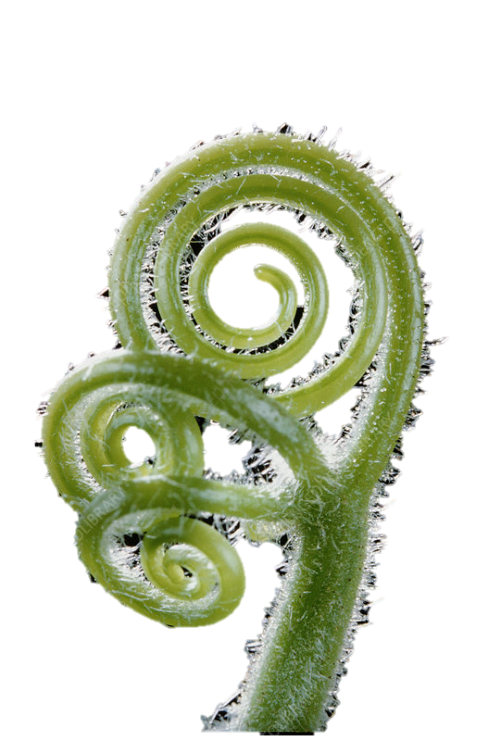
Why Soft Robotics?
Provides safe interaction with humans and the environment.
Enables high flexibility and adaptability in unstructured or tight spaces.
Achieves movements and capabilities that traditional rigid robots cannot.

Slide 5
SOFT ROBOTICS VS TRADITIONAL ROBOTICS
Category | Soft Robotics | Traditional Rigid Robotics
Materials | Silicone, rubber, elastomers, gels | Metals, aluminum, steel, hard plastics
Safety | Very safe; low risk of injury; ideal for human interaction | Higher injury risk; requires safety barriers
Flexibility | Highly flexible; can bend, twist, stretch | Limited flexibility; fixed joints
Cost | Lower material cost but complex manufacturing | Higher material cost but easier manufacturing
Pros | Safe, adaptive, lightweight, biomimetic movement | Strong, fast, precise, reliable.
Cons | Hard to control, less precise, limited power | Unsafe for close contact, rigid, less adaptable

Slide 6
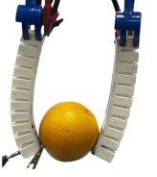
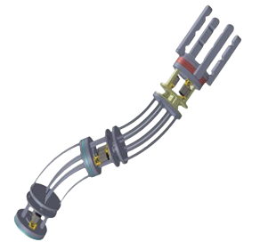
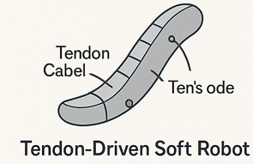
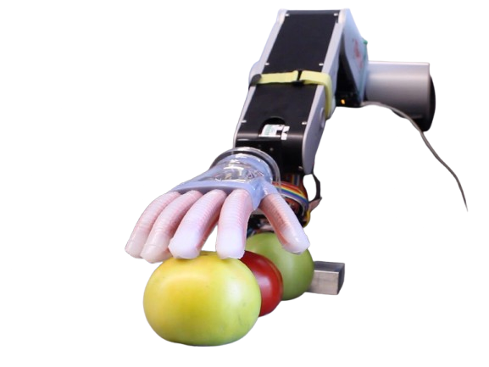
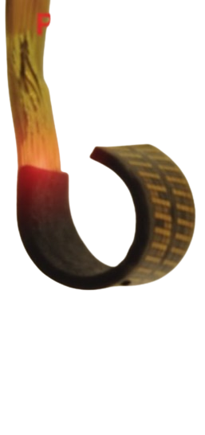
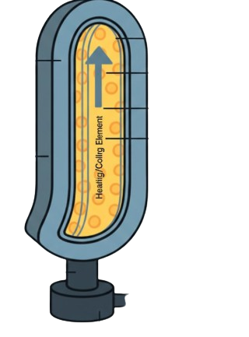
ACTUATION MECHANISMS
PNEUMANIC & HYDRAULIC ACTUATORS
TENDON-DRIVEN ACTUATORS
Pressurized air or liquid inflates chambers.
Produces bending, twisting, or extension.
Cables embedded in silicone pull like biological muscle fibers.
ELECTROACTIVE POLYMERS
VARIABLE-STIFFNESS SYSTEMS
Granular jamming, layer jamming, phase-change materials.
Allow robots to switch between soft and firm states.
Materials that deform under electrical fields.
Lightweight, silent, smooth motion.

Slide 7
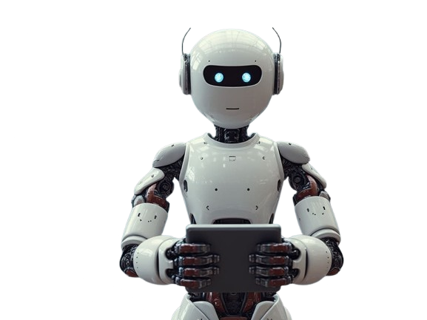

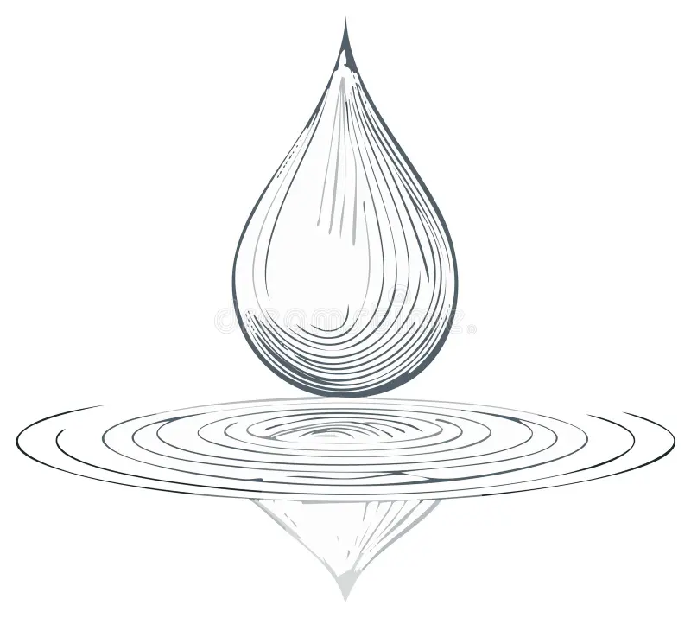
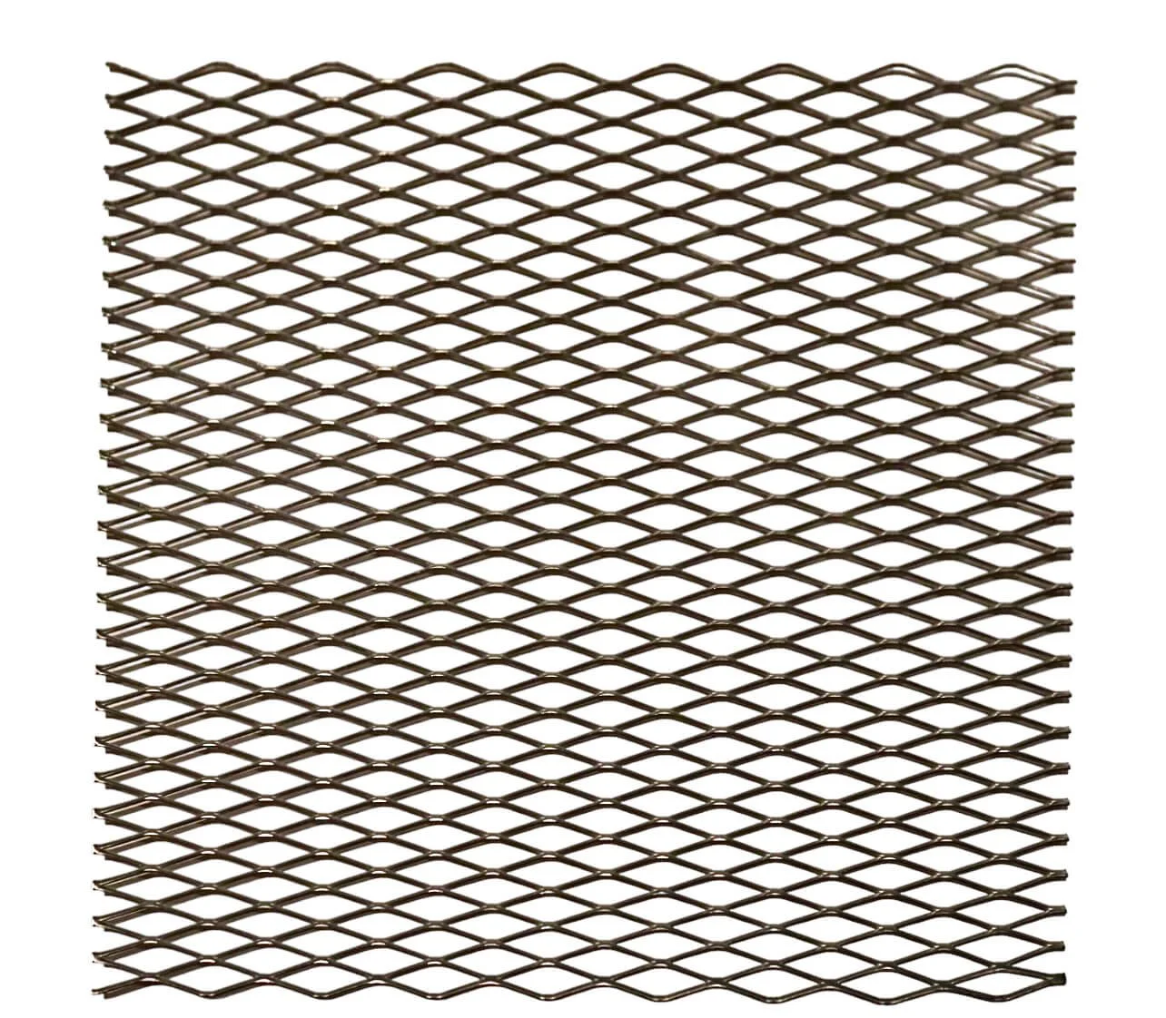

MATERIAL USED IN SOFT ROBOTICS
Silicone elastomers (PDMS) – most common soft robot material.
Elastomers & hydrogels – stretchable, biocompatible.
Auxetic materials – expand under tension, useful for morphing.
Textiles & Fiber reinforcements – control bending directions.

Slide 8
SENSORS USED IN SOFT ROBOTICS
Capacitive Sensors:
Detect bending, stretching, and pressure changes
Made from flexible dielectric layers
Resistive Strain Sensors:
Change electrical resistance when stretched, Simple, low-cost, and easy to integrate, Used for monitoring deformation and elongation
Optical Fiber-Based Sensing:
Uses light signals inside stretchable optical fibers
Highly accurate for curvature, strain and shape sensing, Immune to electrical noise
Liquid Metal Sensors:
Use microchannels filled with liquid metals (e.g., Gallium–Indium), Extremely flexible and self-healing, Ideal for continuous deformation measurement.

Slide 9
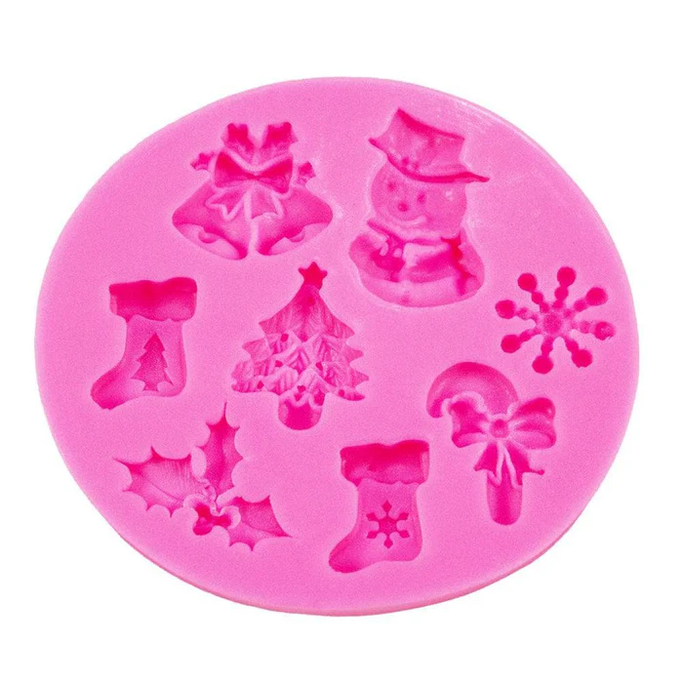
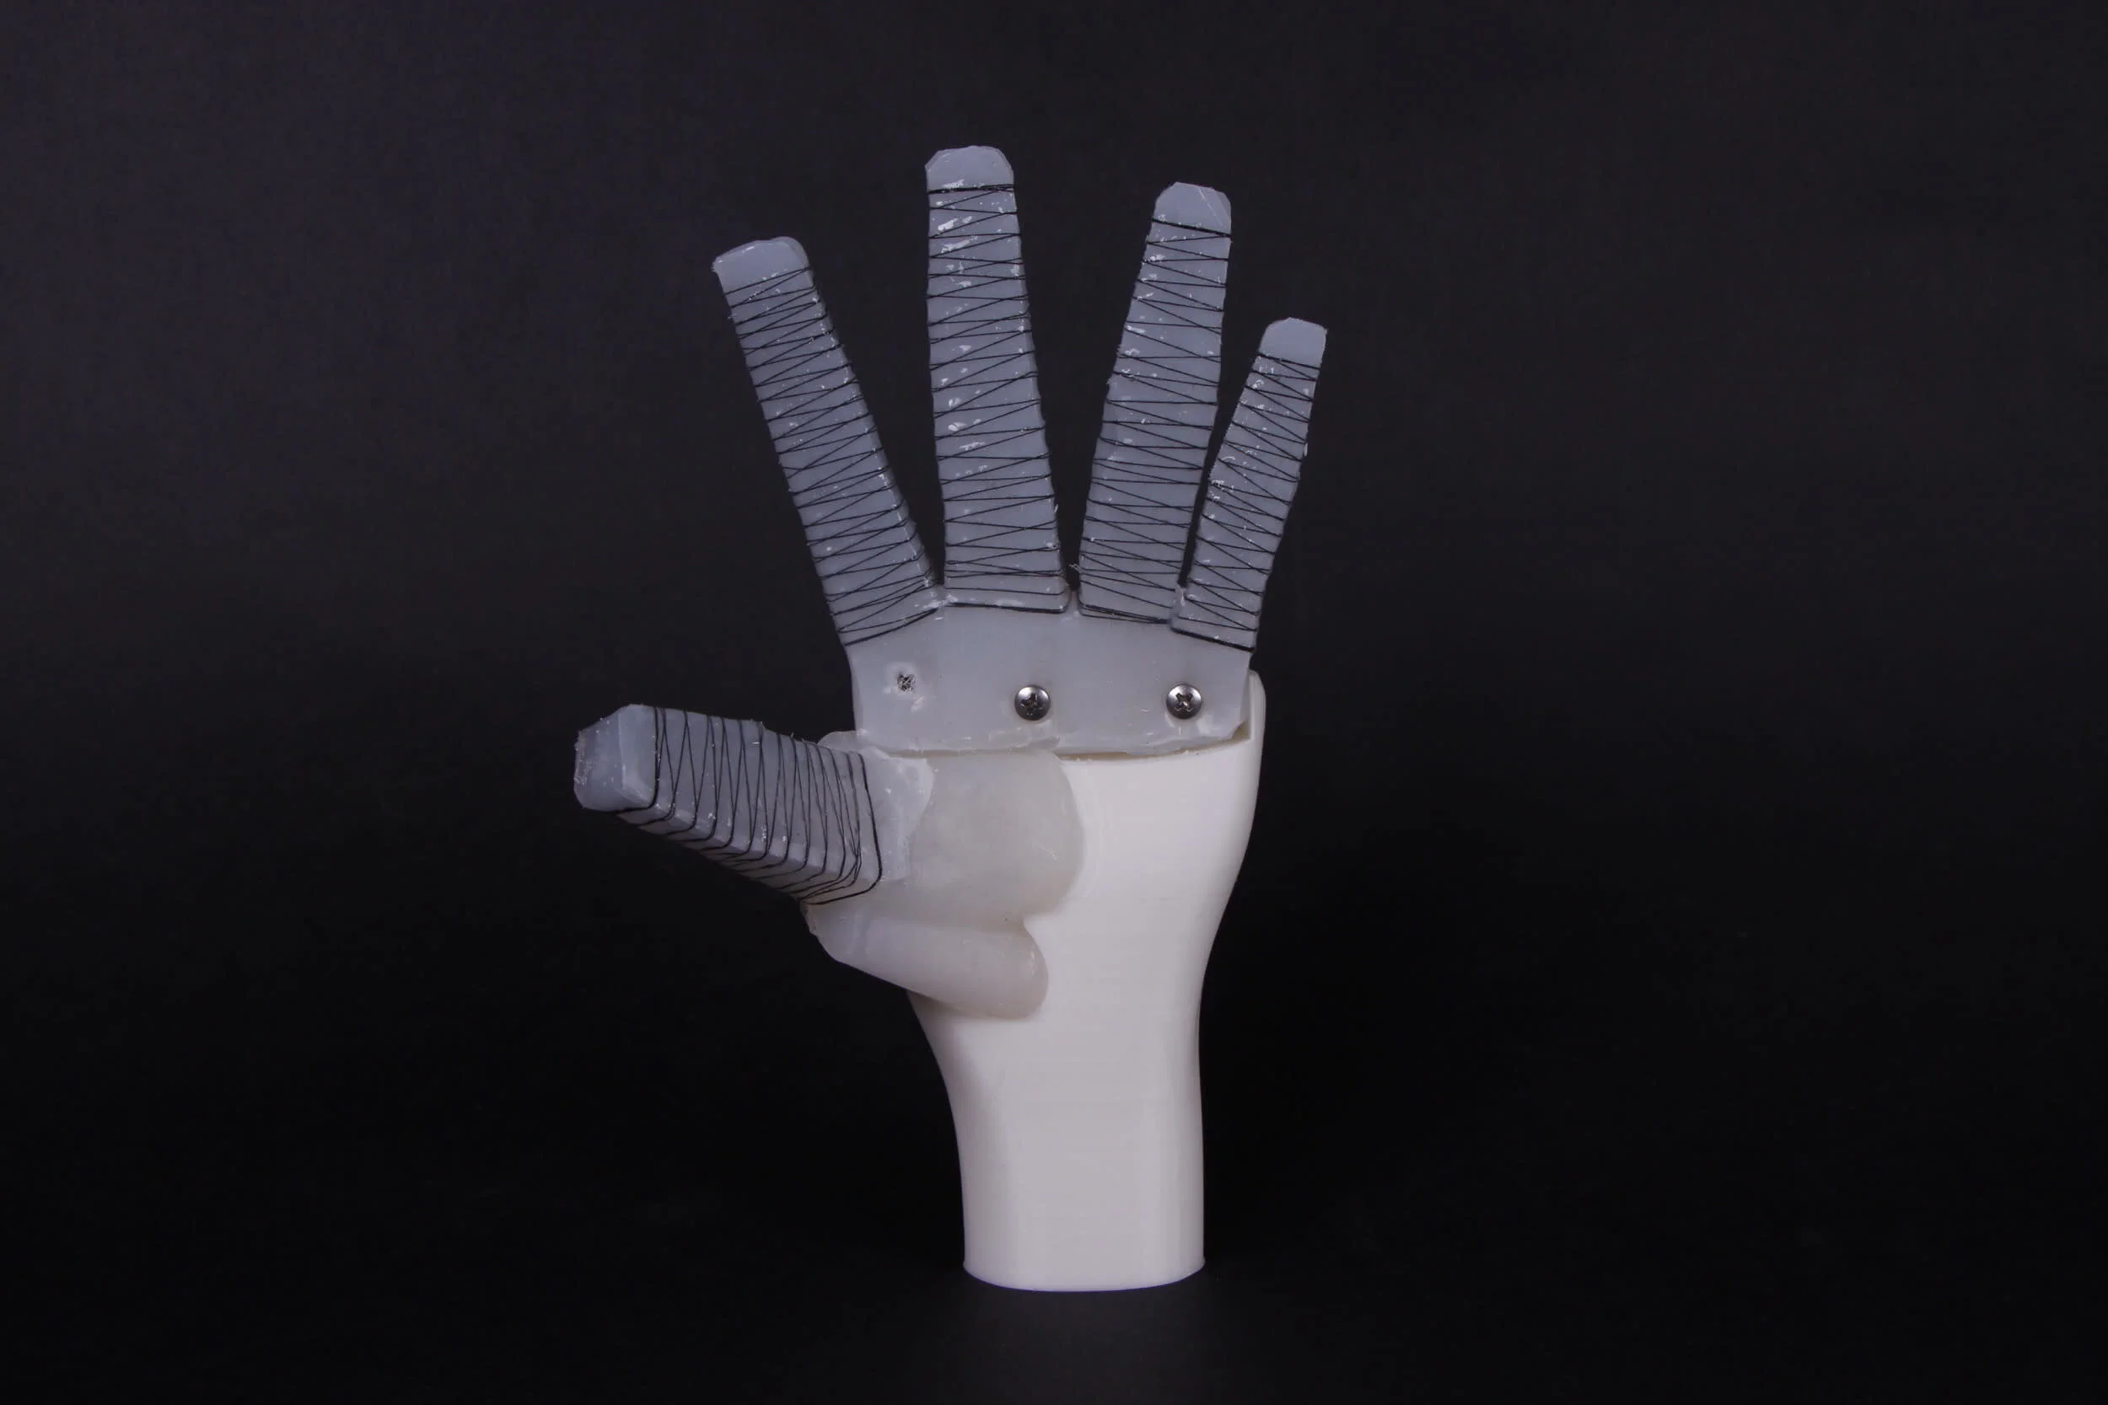
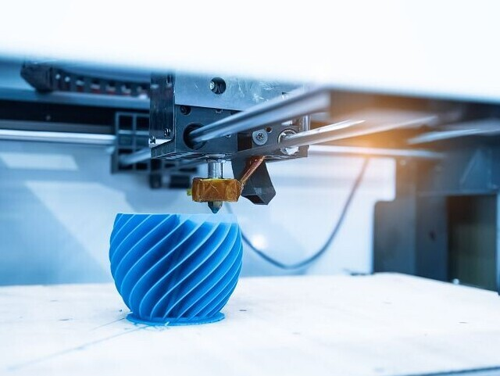

MANUFACTURING TECHNIQUES
MOLDING & CASTING
REINFORCEMENT LAYERS
THIN-FILM FABRICATION
3D PRINTING & MULTIMATERIAL PRINTING
Used for fluidic actuators with internal channels.
Simple and cost-effective.
Laser patterning, spin coating, micromolding
Used for micro-scale robots.
Adding fibers, cloth, or paper to guide movement
Enables complex shapes, internal channels, soft-rigid hybrids

Slide 10
CONTROL & MODELLING CHALLENGES
Soft robots do not have fixed joints → infinite degrees of freedom.
Motion is continuous and nonlinear.
Modelling Approaches:
Beam mechanics
Finite Element Models (FEM)
Data-driven machine learning
Piecewise Constant Curvature (PCC)
Control Methods:
Pressure/volume control
Visual serving
Curvature feedback
Embedded soft sensors

Slide 11
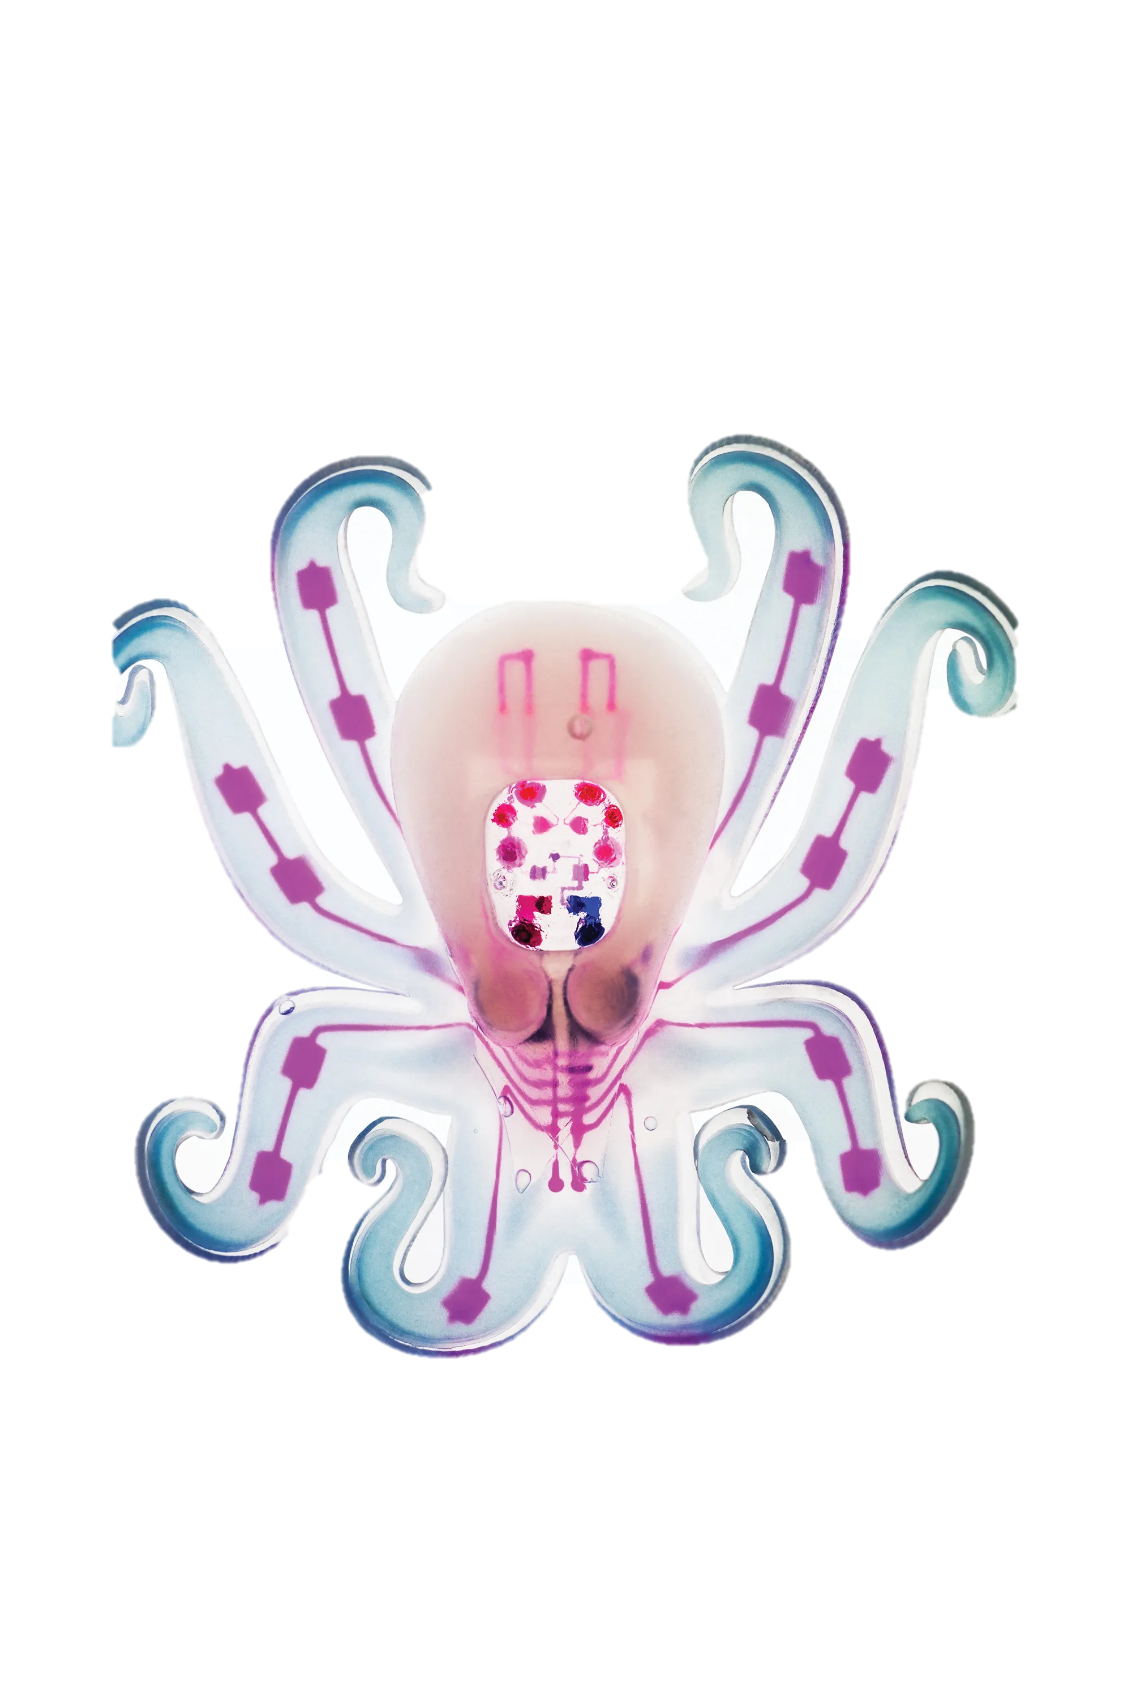
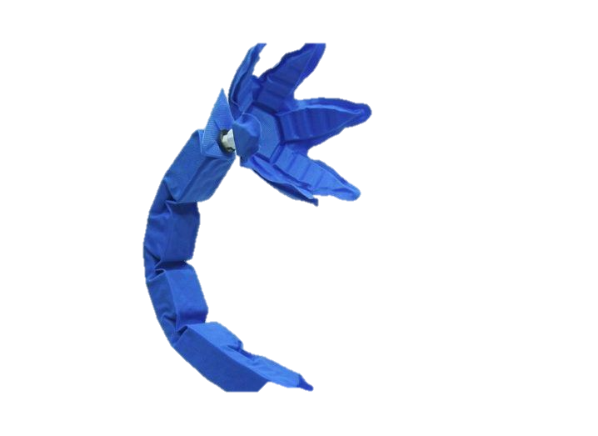
REAL-WORLD APPLICATION
LOCOMOTION
MANIPULATION
MEDICAL & WEARABLE DEVICES
Crawling, swimming, rolling, slithering robots
Ideal for cluttered or dangerous environments
Soft grippers for fragile items.
Used in food handling and warehousing
Soft rehabilitation gloves
Soft exosuits
Wearable gait sensors
Soft surgical tools
BIOHYBRID ROBOTICS
Powered using living cells (e.g., jellyfish robots with cardiac cells).

Slide 12
REAL-WORLD APPLICATION
AGRICULTURE
SPACE ROBOTICS (NASA)
UNDERWATER EXPLORATION
Soft robotic grippers for fruit picking
Gentle handling of fragile crops (tomatoes, strawberries)
Soft robotic fish and tentacles for coral reef studies
Safe interaction with marine life
Bio-inspired soft robots for planetary exploration
Safe movement on uneven or unknown terrain
MEDICAL ROBOTICS
Soft endoscopes for minimally invasive surgery
Soft robotic tools for delicate tissue manipulation

Slide 13
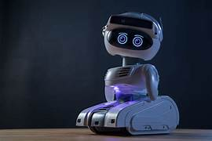
RECENT RESEARCH TRENDS (2023–2025)
Soft Robotic Swarms:
Multiple small soft robots working together
Inspired by biological systems (ants, fish, jellyfish)
Useful in search-and-rescue, environmental monitoring, and exploration
AI-Driven Soft Robot Control:
Machine learning models used to predict & control nonlinear soft movements
Enables real-time sensing, adaptive grasping, and autonomous decision-making
Helps overcome the complexity of soft robot modeling
Multi-Material 3D Printing:
Advanced printers combine flexible + rigid materials in one structure
Enables soft actuators with embedded sensors
Supports rapid prototyping of custom soft robots
Untethered Soft Robots:
Powered by onboard micro-batteries, chemical fuels, or wireless energy
No tubes or wires required for movement
Paves the way for fully autonomous soft robots for field operations

Slide 14
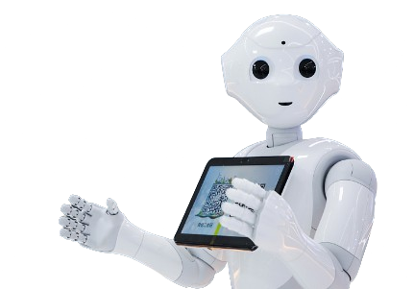
FUTURE CHALLENGES
Need fully soft electronics, batteries, processors.
Complex modeling due to nonlinear deformations..
Stronger and faster soft actuators
Better manufacturing for integrated soft systems.
Development of untethered autonomous soft robots.

Slide 15
FUTURE SCOPE & OPPORTUNITIES IN SOFT ROBOTICS
Soft Robots in Medical Diagnostics
Search & Rescue in Disaster Zones
Robotic Wearables for Elderly Care
Sustainable Soft Materials
Integration with AI & Digital Twins

Slide 16
CONCLUSION
Soft robotics combines materials science, biology, and advanced manufacturing
Finite Element Models (FEM) Enables new capabilities impossible for rigid robots.
Promising future in healthcare, exploration, human–robot interaction, and industry.
Research continues toward fully autonomous soft robotic systems.

Slide 17
THANK YOU

